Slide 1

Jerry Liu (CEO)
Ryne Watterson (CIO)
Keith Leung (CTO)
Jeffery Yeung (CCO)
Scott Checko (COO)

Slide 2
Presentation Overview
Background & Motivation
Business & Cost Analysis
System Overview
Risk Assessment
Engineering Standards
Self Reflection
Concluding Remarks
Demo
Questions

Slide 3
Introduction

Slide 4
Background
Approx. 500,000 commercial buildings in Canada [1]
135 fire related deaths per year from 2010-2014 in Canada [2]
High Earthquake Potential on Canadian West Coast
Modernize safety in urban/industrial environments
Complex urban structures
More buildings & people in smaller areas
Navigation in these areas is more difficult in emergencies
Introduction | Market Analysis | Technical Overview | Risk Assessment | Standards | Reflection | Summary

Slide 5

Motivation
Optimizing Emergency Response
Limited information on scene
Victim location based on witness accounts
Unreliable and high tendency of human error
What happens when disaster strikes?
Increase Safety & Efficiency
More reliable information
Better path planning
Limit human error
Safer for first responders
Introduction | Market Analysis | Technical Overview | Risk Assessment | Standards | Reflection | Summary

Slide 6
Indoor Positioning Systems (IPS) Attributes [3]
System accuracy and precision
Coverage and resolution
Latency in making location updates
Building’s infrastructure impact
Effect of error/interference on the system
Introduction | Market Analysis | Technical Overview | Risk Assessment | Standards | Reflection | Summary
Notes:
For any IPS there are 5 main attributes to be considered

Slide 7
Akriveia Beacon System
Indoor Positioning System (IPS)
Designed for Disaster Search & Rescue Operations
System of Anchor Beacons and Wearable ID Tags
Integrated with Advance Ultra-Wideband (UWB) Technology
Trilateration Methods for Tracking
Near Real-Time Indoor Tracking
Introduction | Market Analysis | Technical Overview | Risk Assessment | Standards | Reflection | Summary
Notes:
An indoor positioning system designed for DSARO
System of Anchor Beacons and Wearable ID Tags integrated with Advance Ultra-Wideband (UWB) Technology
Uses trilateration methods to determine location
Can track in near real time

Slide 8
Business & Cost Analysis

Slide 9

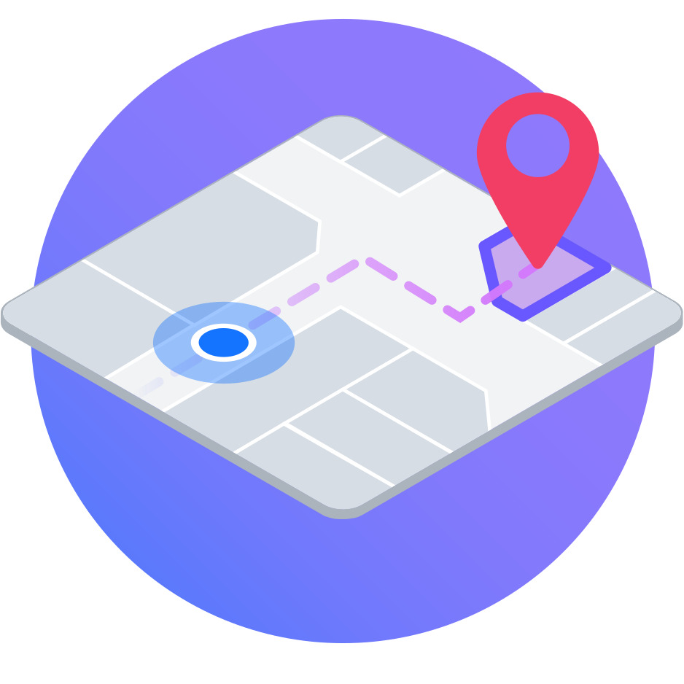
Global Market & Competitors
Search and Rescue (SAR) Equipment Market
In 2017: $113.62 billion [4]
Projected in 2022: $125.66 billion
Global Indoor Location (GIL) Market
In 2015: $3.43 billion [5]
Projected in 2022: $29.4 billion
No Direct Competitors
Pozyx, Infsoft, KAUST Innovation
Introduction | Market Analysis | Technical Overview | Risk Assessment | Standards | Reflection | Summary
Notes:
One great benefit to our product is that it’s uniquely placed between two large markets:
The Search and Rescue equipment market and the Global Indoor Location market
SAR equipment is an old existing market and encompasses emergency vehicles such trucks or helicopters to rescue responders devices such as our beacons and ID tags.
It’s estimated to be at $113.62 billion dollars industry in 2017 and is expected to reach 125.66 bil in 2022.
On the other hand, GIL is an emerging market after the proliferation of smartphone users but also the ineffectiveness of GPS for indoor tracking.
Currently the market is at 3.43 bil in 2015 and is expected to surpass $29.4 bil in 2022.
Our indirect competitors focuses more on application with production and logistics rather than indoor SAR
Uses similar UWB technology but different applications

Slide 10

Target Customer
Ideal Customers
Commercial Building owners
Property management companies
Need for GIL for occupants in emergencies
Government Incentives
System increases occupant safety in emergency situations
Easily integrated into Building Code - Fire Safety
Reduces risk to emergency personnel
Introduction | Market Analysis | Technical Overview | Risk Assessment | Standards | Reflection | Summary
Notes:
Currently our ideal target market is the Commercial Building owners or property management companies
These are two major audiences that would most likely invest in our products.
We saw there was a need for in the GIL market for tracking occupants in emergencies
As well, we are considering to petition for Gov’t incentives to be applied for our product. The reasons being that
Our system increases the occupant safety in emergency situations or the likelihood of being rescued
We are focused on occupant localization during fire emergencies. It could be easily added into the Building Code under Fire safety
Finally, the most important reason is the benefit of reducing risk to emergency personnels, allowing them to go into the fire after being aware of occupant’s locations

Slide 11

Business Plan
Start Up
OEM - One time sales model with SW subscription
Sell Directly, No distributor, higher margin
Build Distributor channel to bring product to market
Growth And Expansion
Acquisition of platforms & tech
Consideration of other application
Hospital, Military, Logistics applications
Possible Exit
Initial Public Offering (IPO)
MBO, MBI
Acquisition
Introduction | Market Analysis | Technical Overview | Risk Assessment | Standards | Reflection | Summary
Notes:
One-Time Sale
No Contracts = Higher sales
Appeals to price-sensitive audience
Inconsistent Revenue Stream
Cost of servicing after initial sale
Subscription Based
Better user experience & up to date service
Steady Revenue Stream
Higher maintenance cost
Requires more work and upkeep for providing service

Slide 12
Business Considerations
Strength / Weaknesses
Unique technology & application
Adoption in new cellular devices
Expensive development cost
Opportunities
Large market in high risk earthquake areas
No direct competitors or similar application in the market
High market share
Risks
Must meet various regulations and standards
Heavily government regulated
Requires new regulations to be put in place
Introduction | Market Analysis | Technical Overview | Risk Assessment | Standards | Reflection | Summary

Slide 13
Production Costs
 | Gamma Prototype | Mass Production
Fixed Cost | $1,000.00 | $24,237.96
Variable Cost Beacon | $127.55 | $36.70
Variable Cost Tag | $74.56 | $22.78
Variable Cost Software | $2,500.00 | $2,500.00
Require Sale Price (80% Return) | $6,530.85 | $5,108.22
Break-Even Point | 1 Units | 6 Unit
Introduction | Market Analysis | Technical Overview | Risk Assessment | Standards | Reflection | Summary
Notes:
We did a new cost analysis to show more realistic price points
Gamma fix costs are cost for R&D for the prototype = 1k
Assuming Each unit is 3 beacon + 10 tag = $1128.25
With $2500 SW licencing price + 80% return, RSP is $6530.85
Mass production fix cost including manufacturing, fabrication, assembly, tooling = 25k
Assuming as a start up we work our of our garage with no salary
Variable cost is much lower since components order directly from manufacturers in bulk & assemble on custom designed PCB

Slide 14
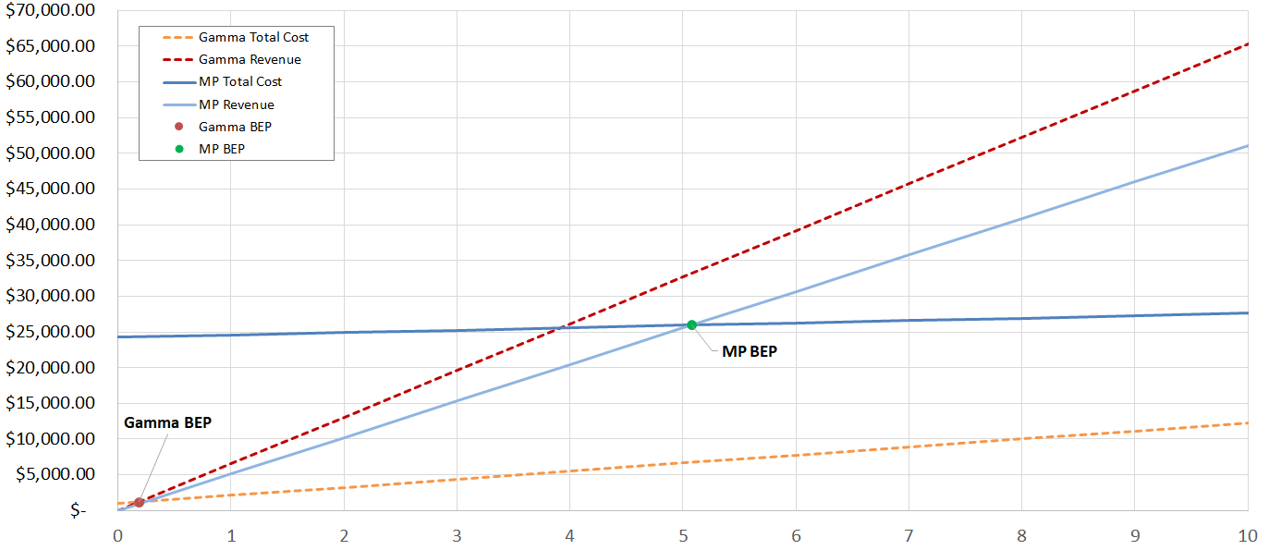
Break-Even Point Calculation
Introduction | Market Analysis | Technical Overview | Risk Assessment | Standards | Reflection | Summary

Slide 15
System Overview

Slide 16
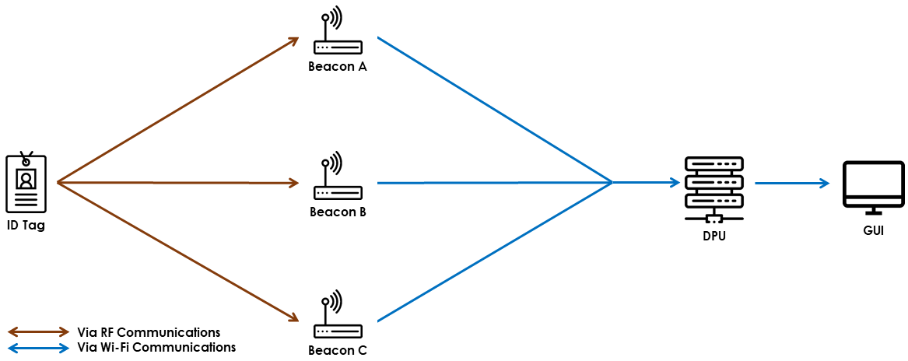
System Layout
Introduction | Market Analysis | Technical Overview | Risk Assessment | Standards | Reflection | Summary
Notes:
ABS is a system of indoor Locator Beacons which can track wearable ID tags using rf signals in the UWB spectrum
Each beacon can detect the distance between itself and an ID tag
and using a Private Wifi network the distance data can be forwarded to a DPU for trilateration processing
The final location info is displayed to the first responders through a GUI

Slide 17
System Components
Beacons
Stationary UWB Locator Devices
Use DWM1000 UWB module for ToF Ranging
Minimum 3 Beacons is Required
Communicate with Server using UDP via Private Network
Tags
Small, Light, durable, and wearable electronic tagging devices
Integrated with DWM1000 UWB Transceivers
Integrate with access cards or key fobs for every day carry
During emergency can be toggled on to broadcast location
Introduction | Market Analysis | Technical Overview | Risk Assessment | Standards | Reflection | Summary

Slide 18

Core System Features
Track position in near real-time
High accuracy upto 0.25cm
Ranging distance upto 30m
Multi-Tag tracking support
Multi-Floor Support
Wireless Beacon-to-Server communication
Beacon failure prevention & recovery mechanisms
Intuitive user interface for adding/editing users, beacons, and maps
Introduction | Market Analysis | Technical Overview | Risk Assessment | Standards | Reflection | Summary
Notes:
We were able to deliver most of the core functions of the system

Slide 19
RF Ranging & Trilateration

Slide 20
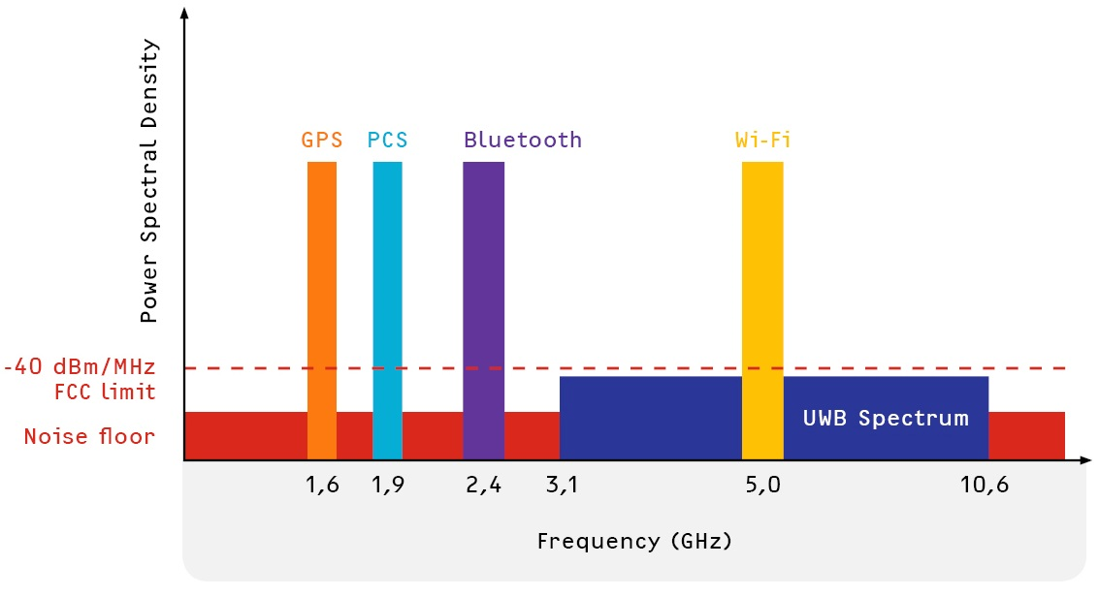
Ultra-Wideband RF Ranging
Time-of-Flight based approach
Minimal interference
Effective against noise
Short duration pulses
Low transmit power
High data rate
Introduction | Market Analysis | Technical Overview | Risk Assessment | Standards | Reflection | Summary
Notes:
RF Ranging is the measurement of distance between transmitter and receiver using metrics that can be retrieved from RF technologies.
Time-of-flight describes the signal travel time from its emission to its return to the source
EM waves travel at speed of light, hence with time-of-light measurement, distance can be calculated

Slide 21
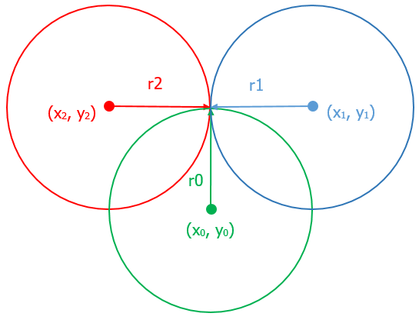
Trilateration Method
Standard Form of a Circle:
(x - x₀)² + (y - y₀)² = r²
r = distance derived from RF ranging
(x₀, y₀) = cartesian coordinates of beacon
Two Dimensional Trilateration:
(x - x₀)² + (y - y₀)² = r₀²
(x - x₁)² + (y - y₁)² = r₁²
(x - x₂)² + (y - y₂)² = r₂²
Introduction | Market Analysis | Technical Overview | Risk Assessment | Standards | Reflection | Summary

Slide 22
Software

Slide 23
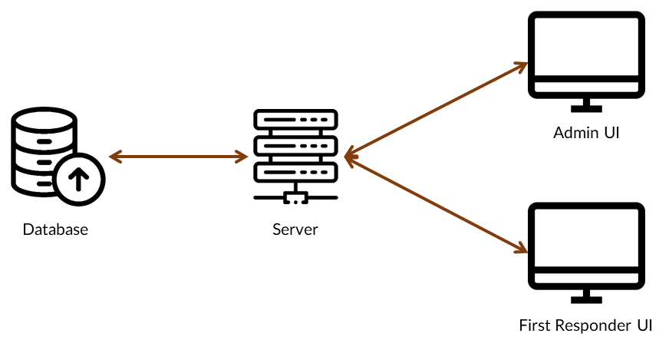
Software Overview
HTTP Web Server
Multi-threaded frontend apps & WebAssembly
Implemented in Rust
Introduction | Market Analysis | Technical Overview | Risk Assessment | Standards | Reflection | Summary
Notes:
The server is the most complicated software component in akriveia

Slide 24
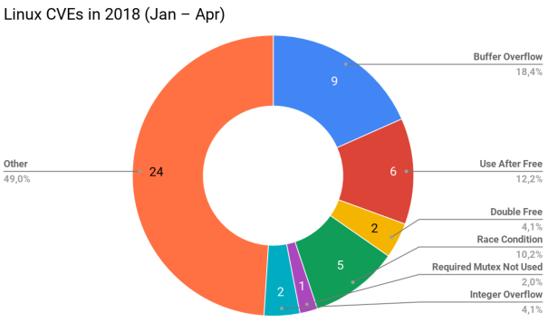
Rust & Software Security
Standard library
Security over performance
Properties of Rust
No Garbage Collector
No Race Conditions
No Buffer Overflow
No Integer Overflow
No Double Free
No Use After Free
Linux Security Vulnerabilities Grouped by Cause [7]
Introduction | Market Analysis | Technical Overview | Risk Assessment | Standards | Reflection | Summary

Slide 25
Risks

Slide 26


Tag Activation
Issue: User unable to turn on tags
Solutions: Automatic Tag Activation
Periodic On/Off
Fall Detection
Heart beat sensor
Oxygen sensor
Remote Trigger
Privacy issue: Have Tag Broadcast Sound
Introduction | Market Analysis | Technical Overview | Risk Assessment | Standards | Reflection | Summary
Notes:
Using the rf harvester we could remote trigger the tags to turn on

Slide 27
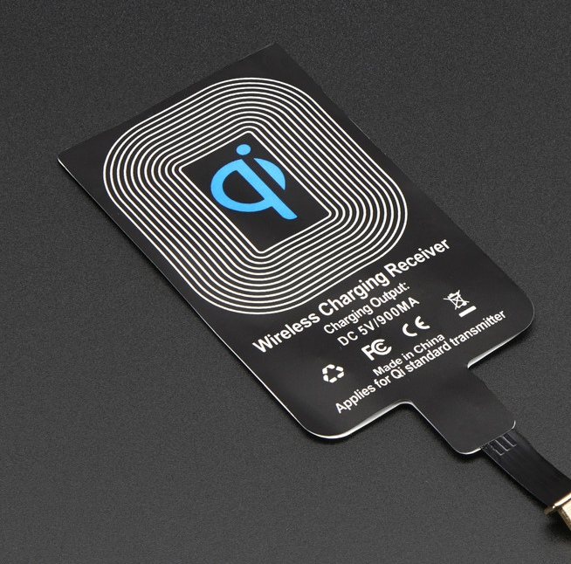
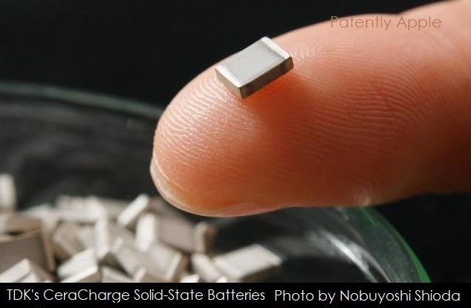
Tag Battery Life & Maintenance
Issue: Low Tag Battery Life & Deterioration
Solutions:
Routine maintenance
Solid State Battery (© 2019 Solid Power)
Wireless charging
RF harvester
Batteryless
Introduction | Market Analysis | Technical Overview | Risk Assessment | Standards | Reflection | Summary
Notes:
Routine maintenance which is costly
SSB = 2.5 x Lith-ion

Slide 28


External Hazard
Issue: Fires, Flood, Gas, Earthquake, Tampering, Hackers
Solutions:
Ingression Protection casing
Fire Resistant Material
Fire safe polymer, fire retardant coating
Carbon foam insulation
Locking mechanism, tamper detection
Improved Network Security
PEAP, EAP-TLS
Introduction | Market Analysis | Technical Overview | Risk Assessment | Standards | Reflection | Summary
Notes:
IP casing - dust/moisture protection
PEAP
Protected Extensible Authentication Protocol
EAP - TLS
Extensible Authentication Protocol - Transport Layer Security

Slide 29

Interference Issue
Issue: Multiple UWB devices increases chance of interference on existing systems operating on the UWB spectrum [6]
Solution: Interference Mitigation:
Modify signal parameters
Pulse Shape
Number of pulses
Off when not used
Introduction | Market Analysis | Technical Overview | Risk Assessment | Standards | Reflection | Summary
Notes:
Emergency responders uses 4G LTE and Wi-Fi, and eventually 5G
This could cause potential interference between our system and

Slide 30
Engineering Standards

Slide 31




Adherence to Standards
Factors to consider:
UWB in commercial environments
Wearable RF Technologies
Software Security & Design
Emergency Equipment Standards
Introduction | Market Analysis | Technical Overview | Risk Assessment | Standards | Reflection | Summary
Notes:
For our engineering standards, we considered these four factors to determine which standards to choose.
Using UWB in commercial environments
Standards of wearable technologies
Software security and design
Emergency equipment standards

Slide 32

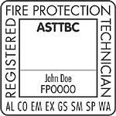

Requirements & Regulations
Relies on government regulation to deploy
Need mix of existing and specific standards
OSHA Placement & Signage requirements
ASTTBC certification
FTP, FSS Code & Material Standards
FCC Wireless Equipment Requirements (US)
Introduction | Market Analysis | Technical Overview | Risk Assessment | Standards | Reflection | Summary
Notes:
Since we rely on government regulation to deloy, we need to follow and develop specific standards for our equipment
In BC Applied Science Technologists & Technicians of BC (ASTTBC) certification will be needed
Follow OSHA requirements for placement in commercial structures
FSS Code International Code for Fire Safety Systems
FTP Code International Code for Application of Fire Test Procedures
Need to meet standards and regulation in other parts of the world such as NFPA (National Fire Protection Association in USA) and USFBC (United States Fire & Building Codes)

Slide 33
Self Reflection

Slide 34
Insights
Success from the project depends on the Team
Clear communication is critical
Execution is vital to success
Good use of online collaboration - GitLab
Overall our team’s skills and attitudes complement each other
Introduction | Market Analysis | Technical Overview | Risk Assessment | Standards | Reflection | Summary
Notes:
Consistent weekly meeting allows us to update each other on project progress/individual tasks.
As well it was a time to build comradeship. We also have meeting minutes to document issues or to allocate tasks to be done.
We communicated clearly on discord or in person to delegate responsibilities or relay information
Time management is a huge factor for any project but we adhered to allocating sufficient time for tasks and following our schedule.
And we utilized online collaboration tools such as Gitlab
Surprisingly our team’s skills and attitudes synergizes with each other.
Our skillsets or lack of expertise complement one another.

Slide 35
Concluding Remarks
Notes:
Overall this has been a very successful project
We haved meet all of our milestones and delivered all of the features promised
We learned a lot about our core tech, about product development and how to solve real world issues
And we will look into some future improvements for our product

Slide 36
Future Development

Slide 37
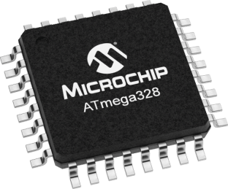
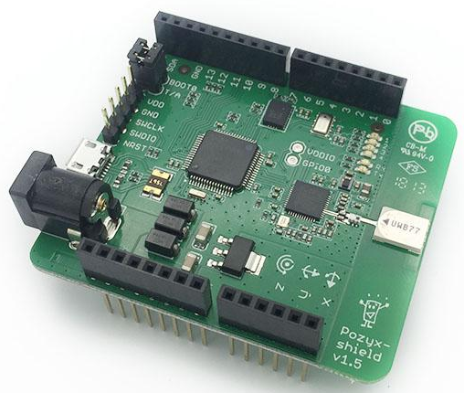
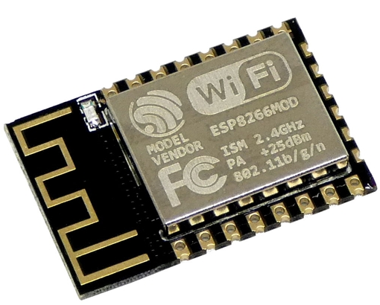
Integrated PCB
Introduction | Market Analysis | Technical Overview | Risk Assessment | Standards | Reflection | Summary
Notes:
Similar to what poxyz has done
We will bring down the size and cost of the hardware drastically
And it will include all of our modules such as the MCU, Wi-Fi and UWB chip
But this will take time and resources to produce and iterate

Slide 38
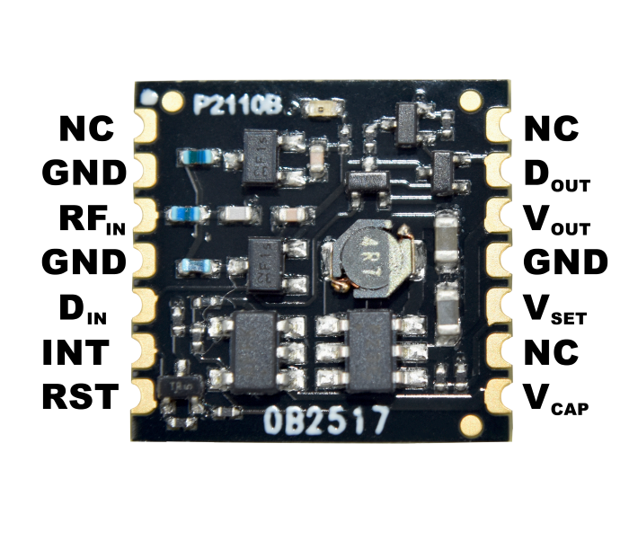
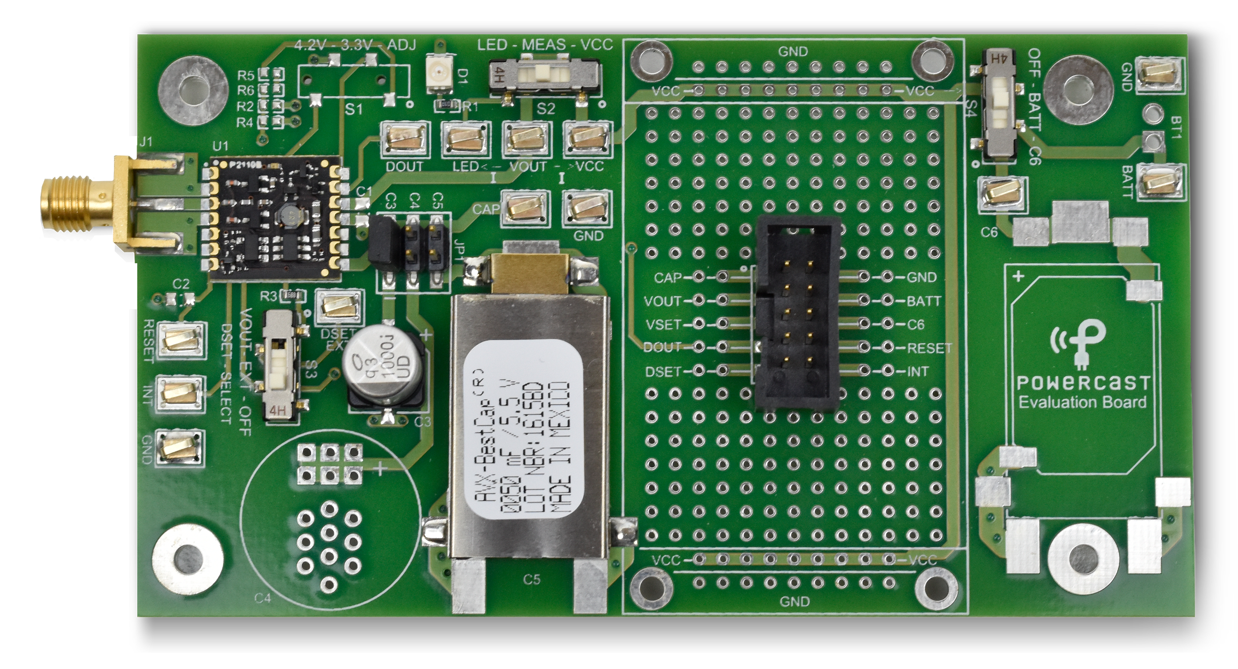

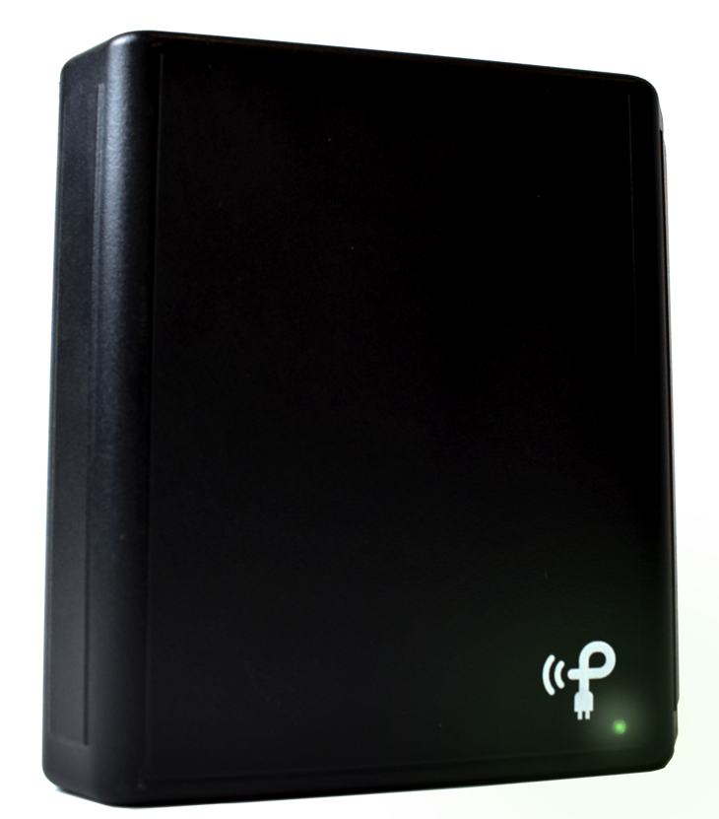
RF Harvester & Powercaster
3W 915MHz Transmitter
Capacitor
P2110B EVA Board
Notes:
2 component tech that can manage power wirelessly
P2110B module (by powercast) contains:
RF to DC converter/rectifier, boost converter
output from transmitter is captured by receiving module
And charges up a capacitor that could be used for powering a circuit or charge battery
Potentially make tags battery free
Could also be used for remote trigger

Slide 39
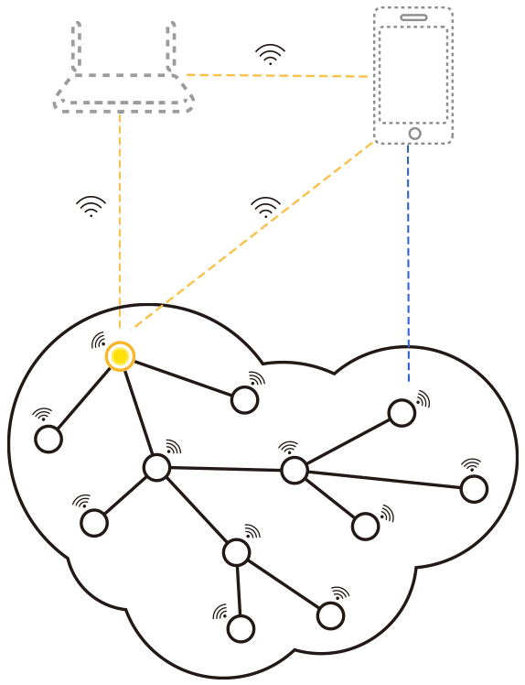
Wi-Fi Mesh
Decentralized Network
Reliable Data Transfer
Wider Coverage
Lower Risk of Failure
Require Better Hardware
Implementation Complexity
Introduction | Market Analysis | Technical Overview | Risk Assessment | Standards | Reflection | Summary
Notes:
Decentralized Network
Beacon Nodes Communicate with each other rather than to a server
Data can hop from node to node
Allows for wider spread of beacons in buildings
Requires more powerful hardware
Implementation Complexity

Slide 40
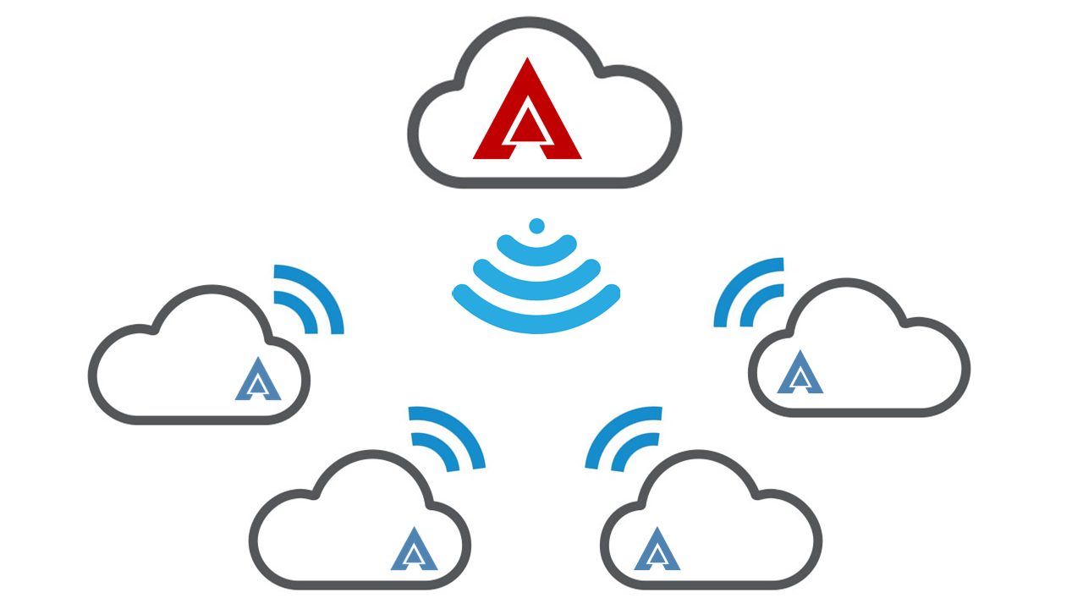
Cloud Management System
Introduction | Market Analysis | Technical Overview | Risk Assessment | Standards | Reflection | Summary
Notes:
In earthquake not just one building will be affected
This could be for managing multiple systems in multiple buildings
Each build has own system
All sending data with remote server (AWS) using open network (WiFi, Cell)
Operators can access and monitor each building remotely
Better scalability, and better management of our platform

Slide 41
Acknowledgements
Quick Thank you to:
Scott’s Dad (Retired Firefighter/Fire Prevention)
Ryne’s Girlfriend’s Dad (Fire Chief)
Raymond Messier (North Shore SAR)
Royce Ng (Amazon Warehouse Safety/SAR)
Introduction | Market Analysis | Technical Overview | Risk Assessment | Standards | Reflection | Summary

Slide 42
Demo

Slide 43
Questions?

Slide 44
References
Statistics Canada. Survey of Commercial and Institutional Energy Use, 2014. [online] Available at: https://www150.statcan.gc.ca/n1/daily-quotidien/160916/dq160916c-eng.htm [Accessed 26 July. 2019].
Statistics Canada, "Fire-related deaths and persons injured, by type of structure", Www150.statcan.gc.ca, 2019. [Online]. Available: https://www150.statcan.gc.ca/t1/tbl1/en/tv.action?pid=3510019501. [Accessed: 26- July- 2019].
S. A.-H. M. A.-A. A. Alarifi A. Al-Salman M. Alsalem A. Alnafessah and H. Al-Khalifa. (2016) Ultra wideband indoor positioning technologies: Analysis and recent advances. [Online] Available: https://www.ncbi.nlm.nih.gov/pmc/articles/PMC4883398/pdf/ sensors-16-00707.pdf.[Accessed:14-Jun-2019]
BusinessWire. (2017) Elbit systems, general dynamics corporation, honeywell, leonardo ... - research and markets. [Online]. Available: [Online]. Available:https://www.businesswire.com/news/home/20170901005591/en/ Search-Rescue-SAR-Equipment-Market---Forecast.[Accessed:14-Jun-2019]
Reuters. (2018) Indoor location market 2018 global trends, market share, industry size, growth, opportunities and forecast to 2023. [Online]. Available: [Online].Available:https: //www.reuters.com/brandfeatures/venture-capital/article?id=50849.[Accessed:14-Jun-2019]
UWB and WLAN Coexistence: a Comparison of Interference Reduction Techniques, 2005 [Online] Available at: https://scholarcommons.usf.edu/cgi/viewcontent.cgi?article=1712&context=etd. [Accessed 24 November, 2019]
Philipp Oppermann, The Rust way of OS development, 2018 [Online] Available at: https://phil-opp.github.io/talk-konstanz-may-2018/#1. [Accessed 2 December, 2019]

